Slide 1
BY:
Fake Currency Detection

Slide 2
Problem Statement
Money drives economic activities like manufacturing, circulation, circulation and consumption, making it essential in today's society.
. However, counterfeit currency is a growing threat, harming everyday people and shrinking the economy.
. Counterfeit notes, especially in Rs. 500 and Rs. 1,000 denominations, are hard to detect, affecting transactions at every level. Globally, the issue is a concern.
.In India, fraud cost banks Rs. 16,789 crores in one year, and counterfeit notes have surged, with a significant rise reported in Rs. 500 (101.9%) and Rs. 2,000 (54.6%) notes, according to the RBI's 2021–22 report.

Slide 3
Objectives
1. To examine the various security components of Indian currency notes.
2. Using a scanner or camera to gather paper money.
3. To extract characteristics from the captured image by cropping and segmenting it.
4. Creating a feature localization algorithm.
5. Designing an extraction and recognition of features.
6. To determine the right money denomination.
7. To distinguish between authentic and fake money notes

Slide 4
Hardware Requirement
Software Requirement
Processor | 2 GHz
Intel Storage | 512GB
RAM | 4GB
Operating System | Windows 7 and greater or MacOS or Linux
Programming Language | Python
IDE(Integrated Development Environment) | VS Code

Slide 5
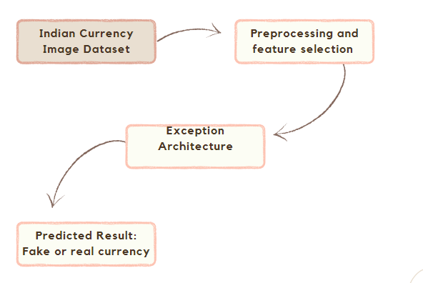
System Architecture

Slide 6
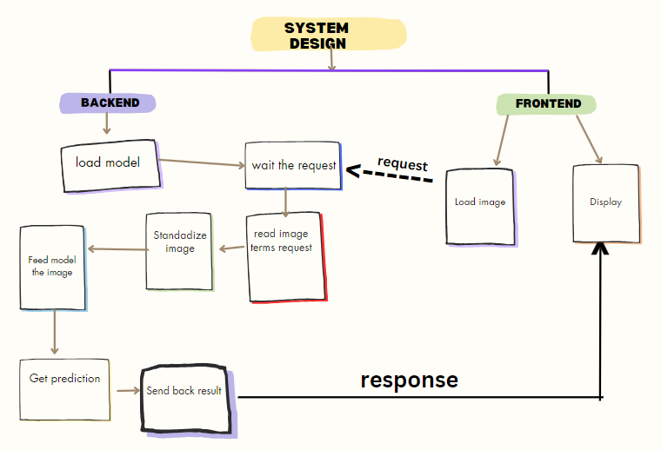
System Design
a

Slide 7
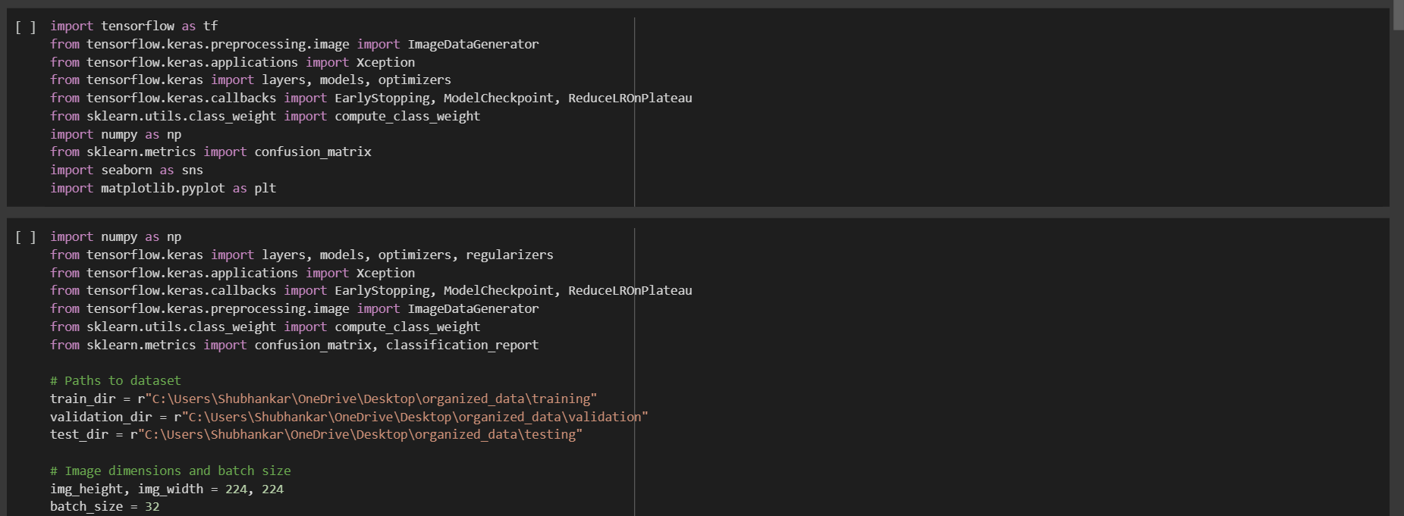
Model Train Code

Slide 8


Slide 9


Slide 10


Slide 11
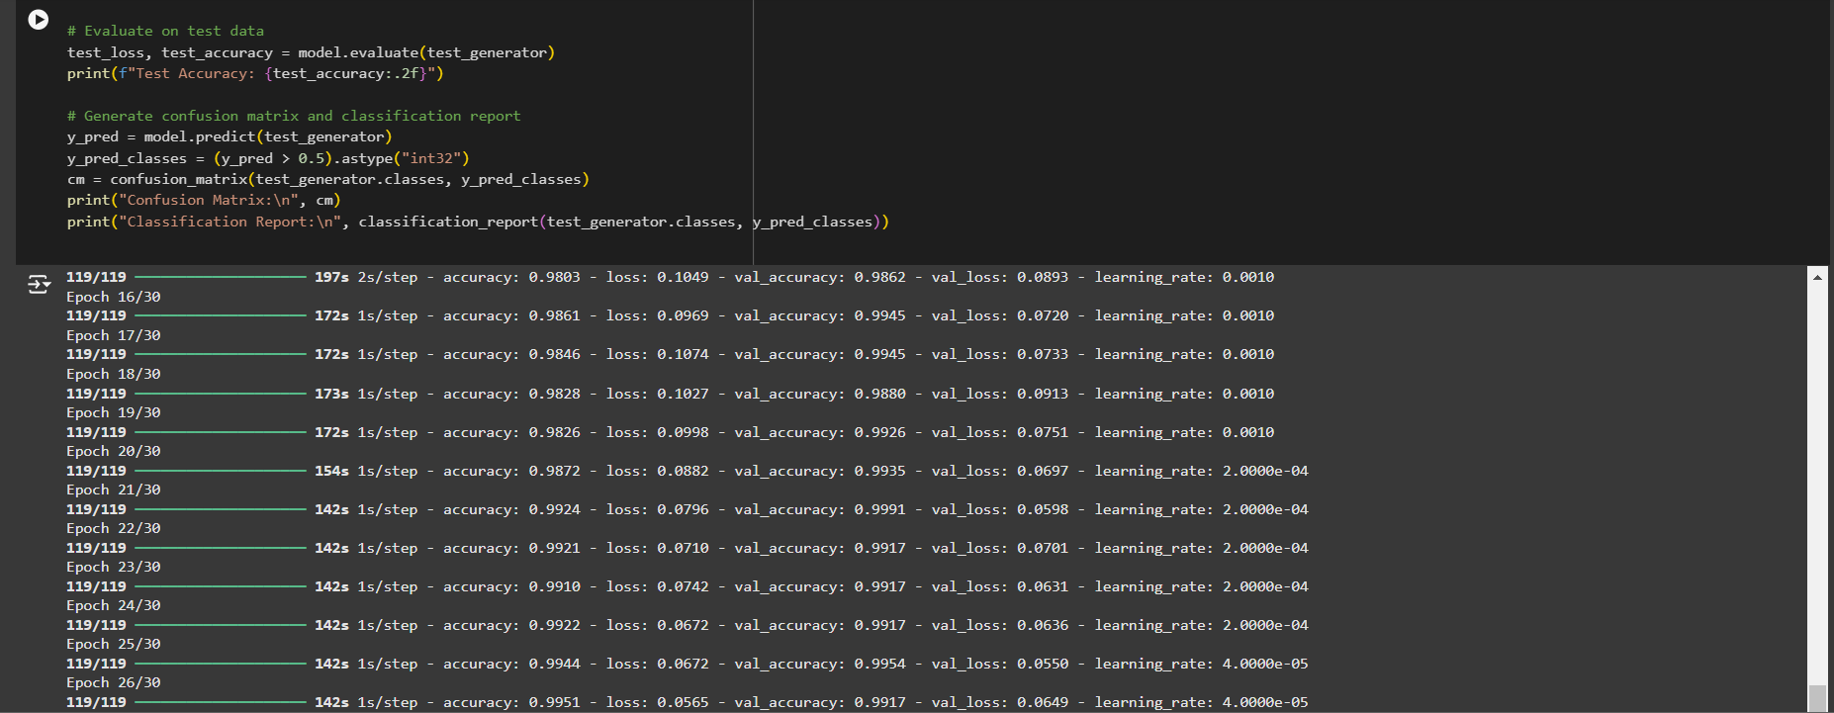

Slide 12
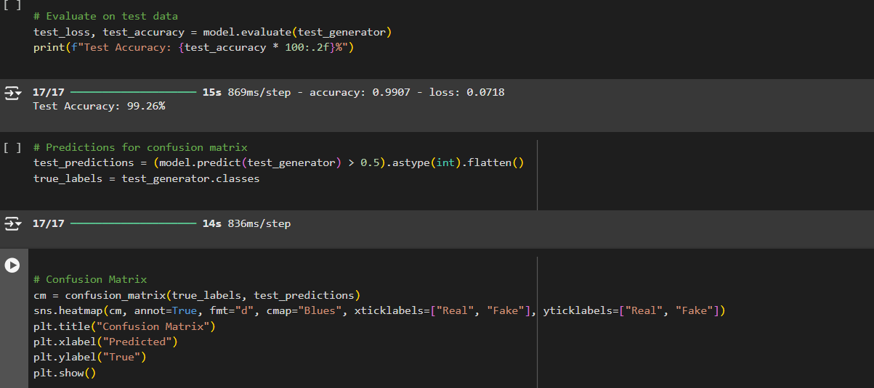

Slide 13
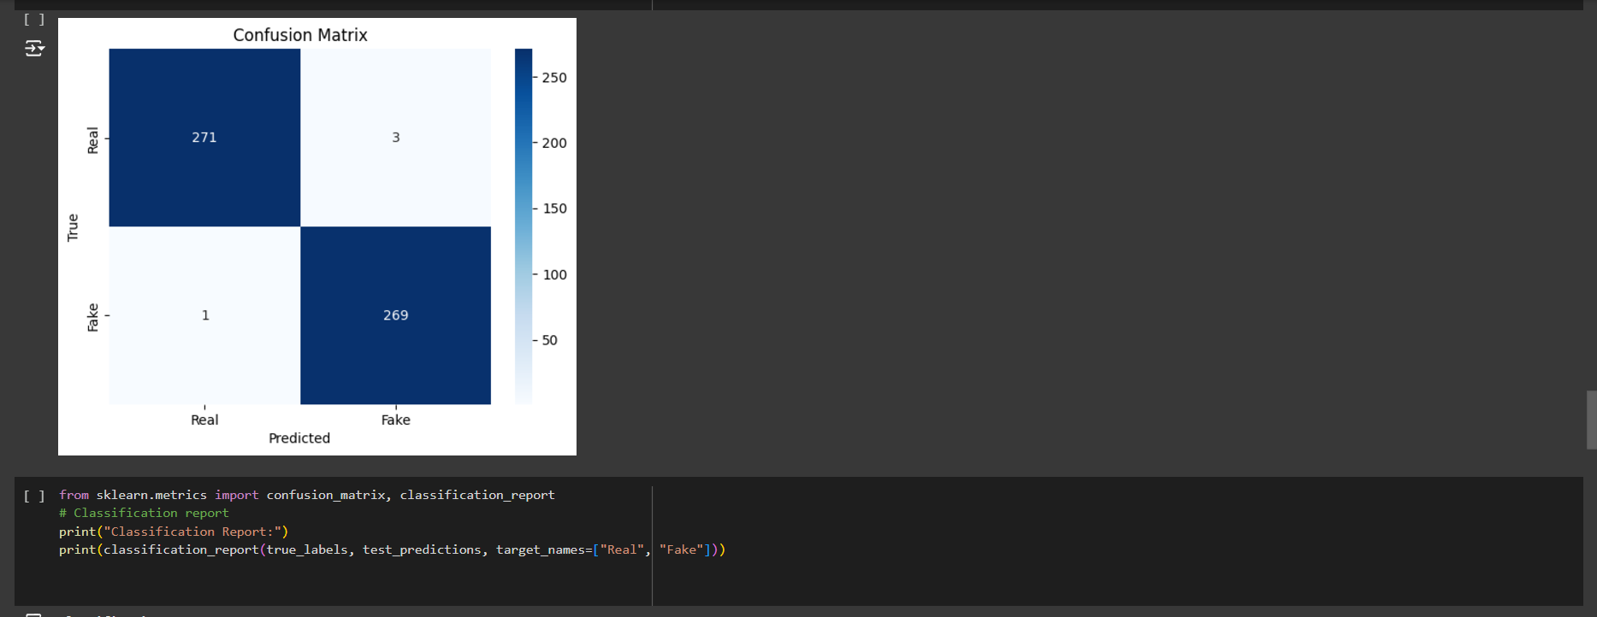

Slide 14
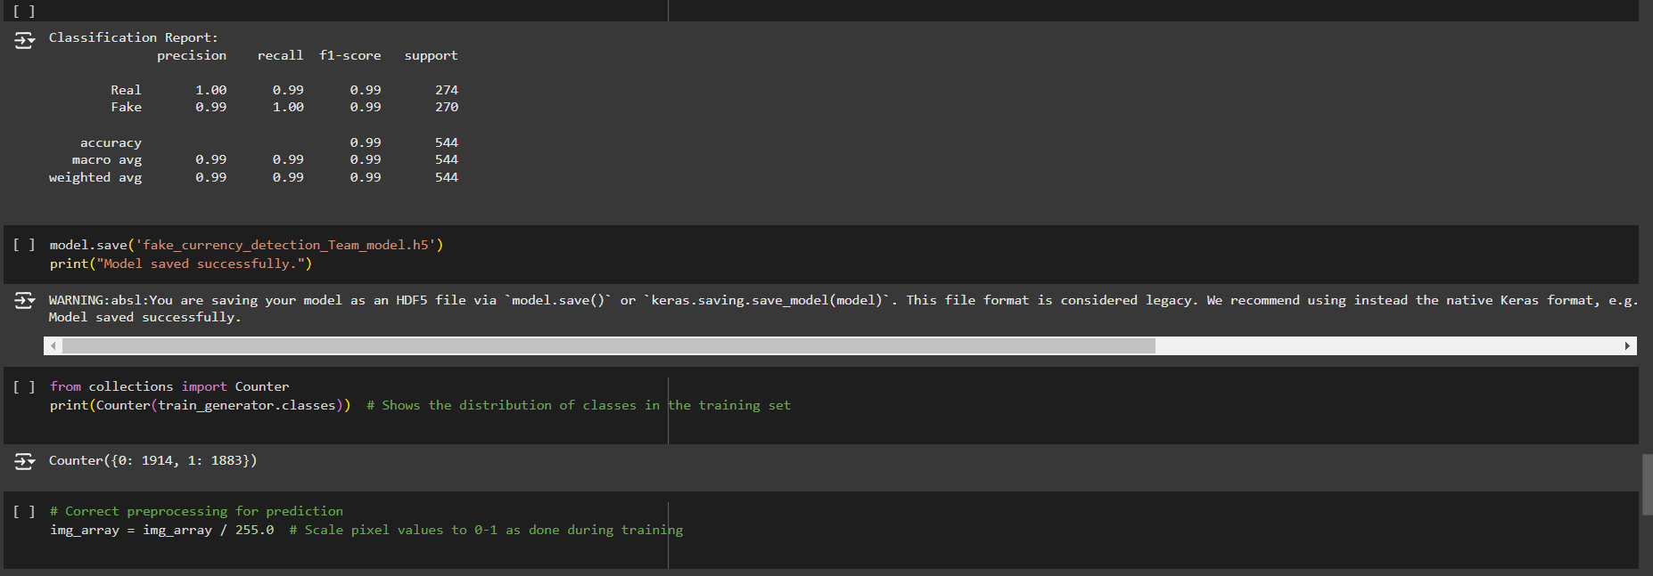

Slide 15
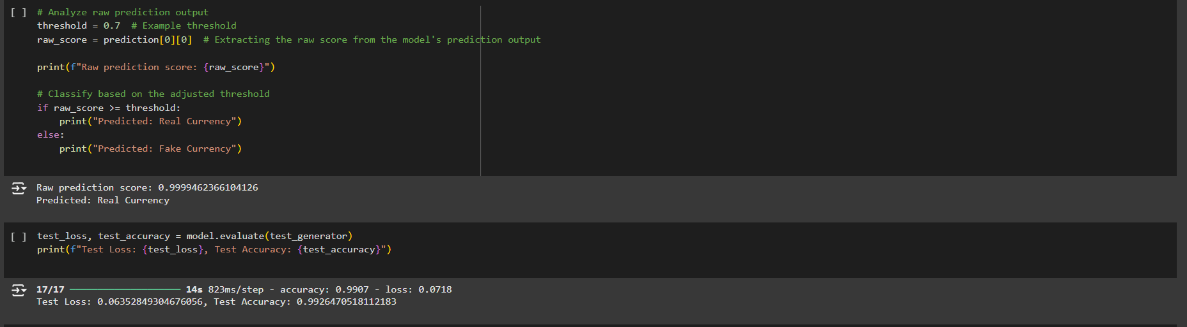

Slide 16
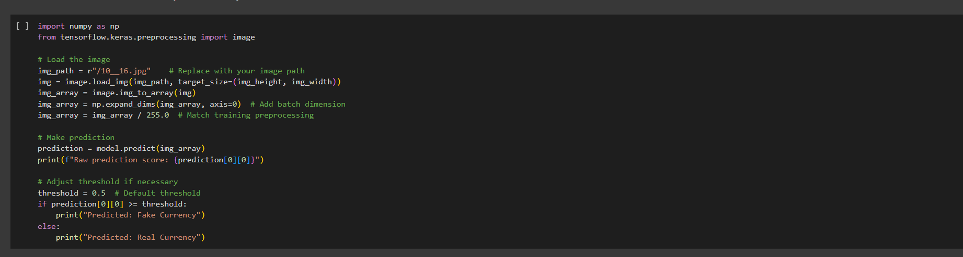

Slide 17
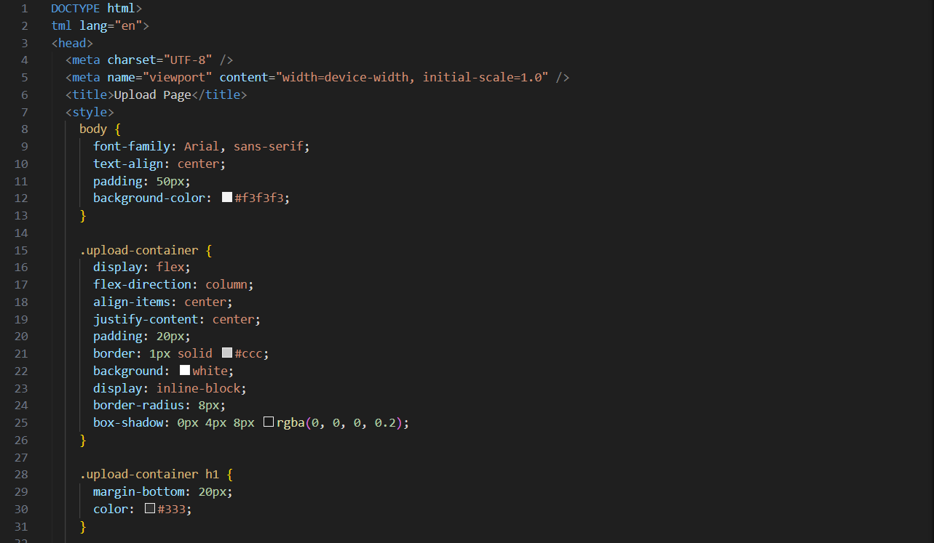
Fronted Code

Slide 18


Slide 19
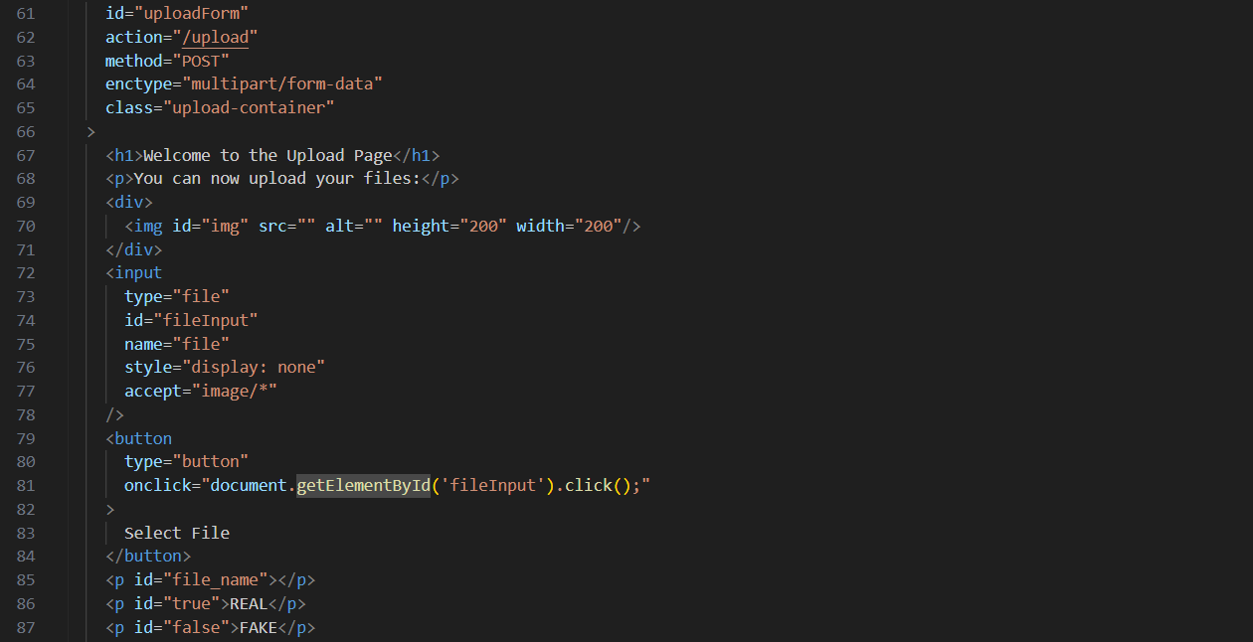

Slide 20
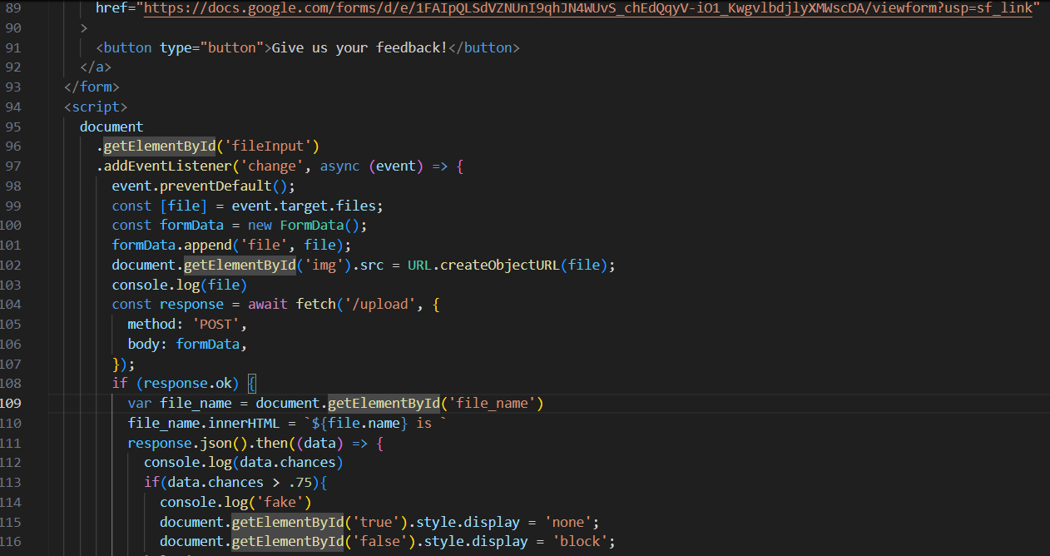

Slide 21


Slide 22
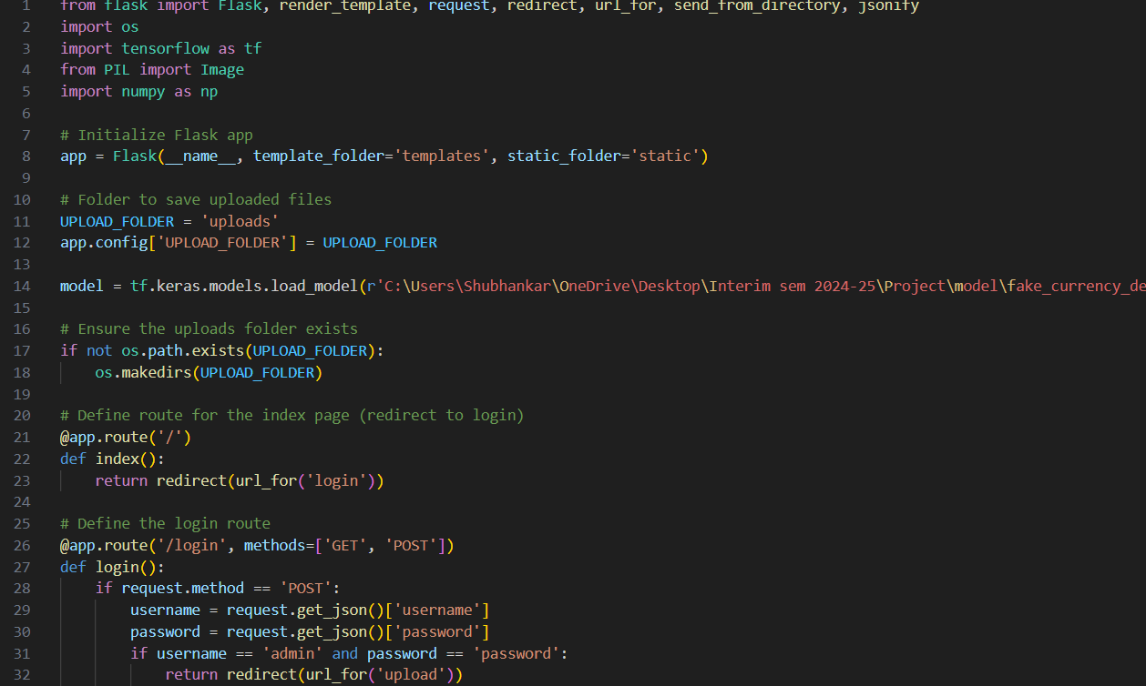
Backend Code

Slide 23
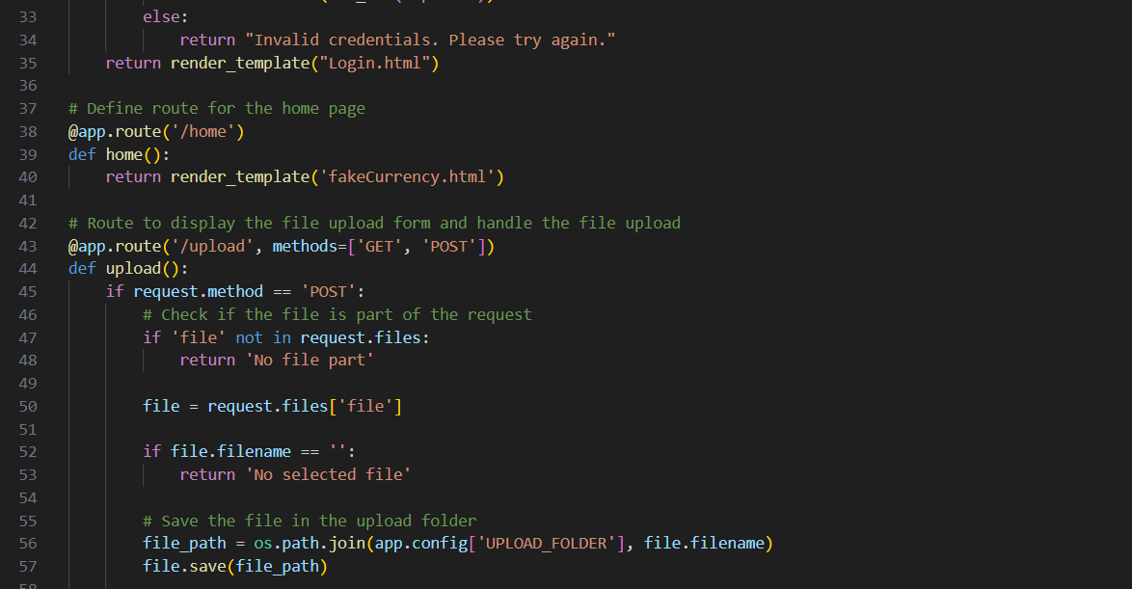

Slide 24
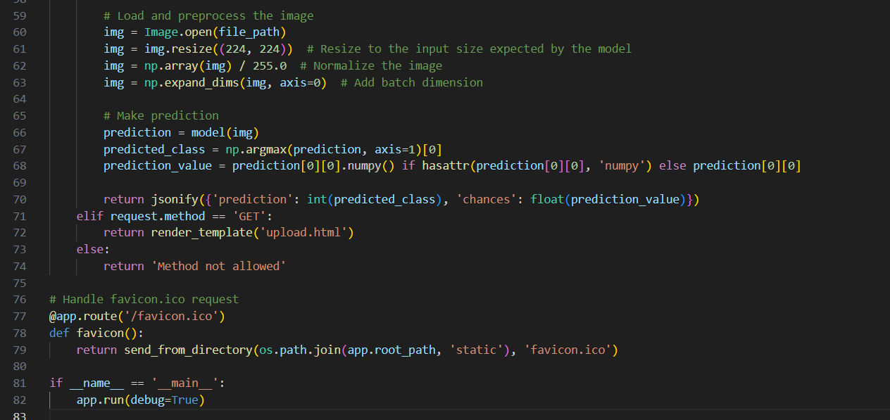

Slide 25
Thank you

